Slide 1
Session 5
ITS Infinity Roadmap
Presented By: Clinton Naidu

Slide 2
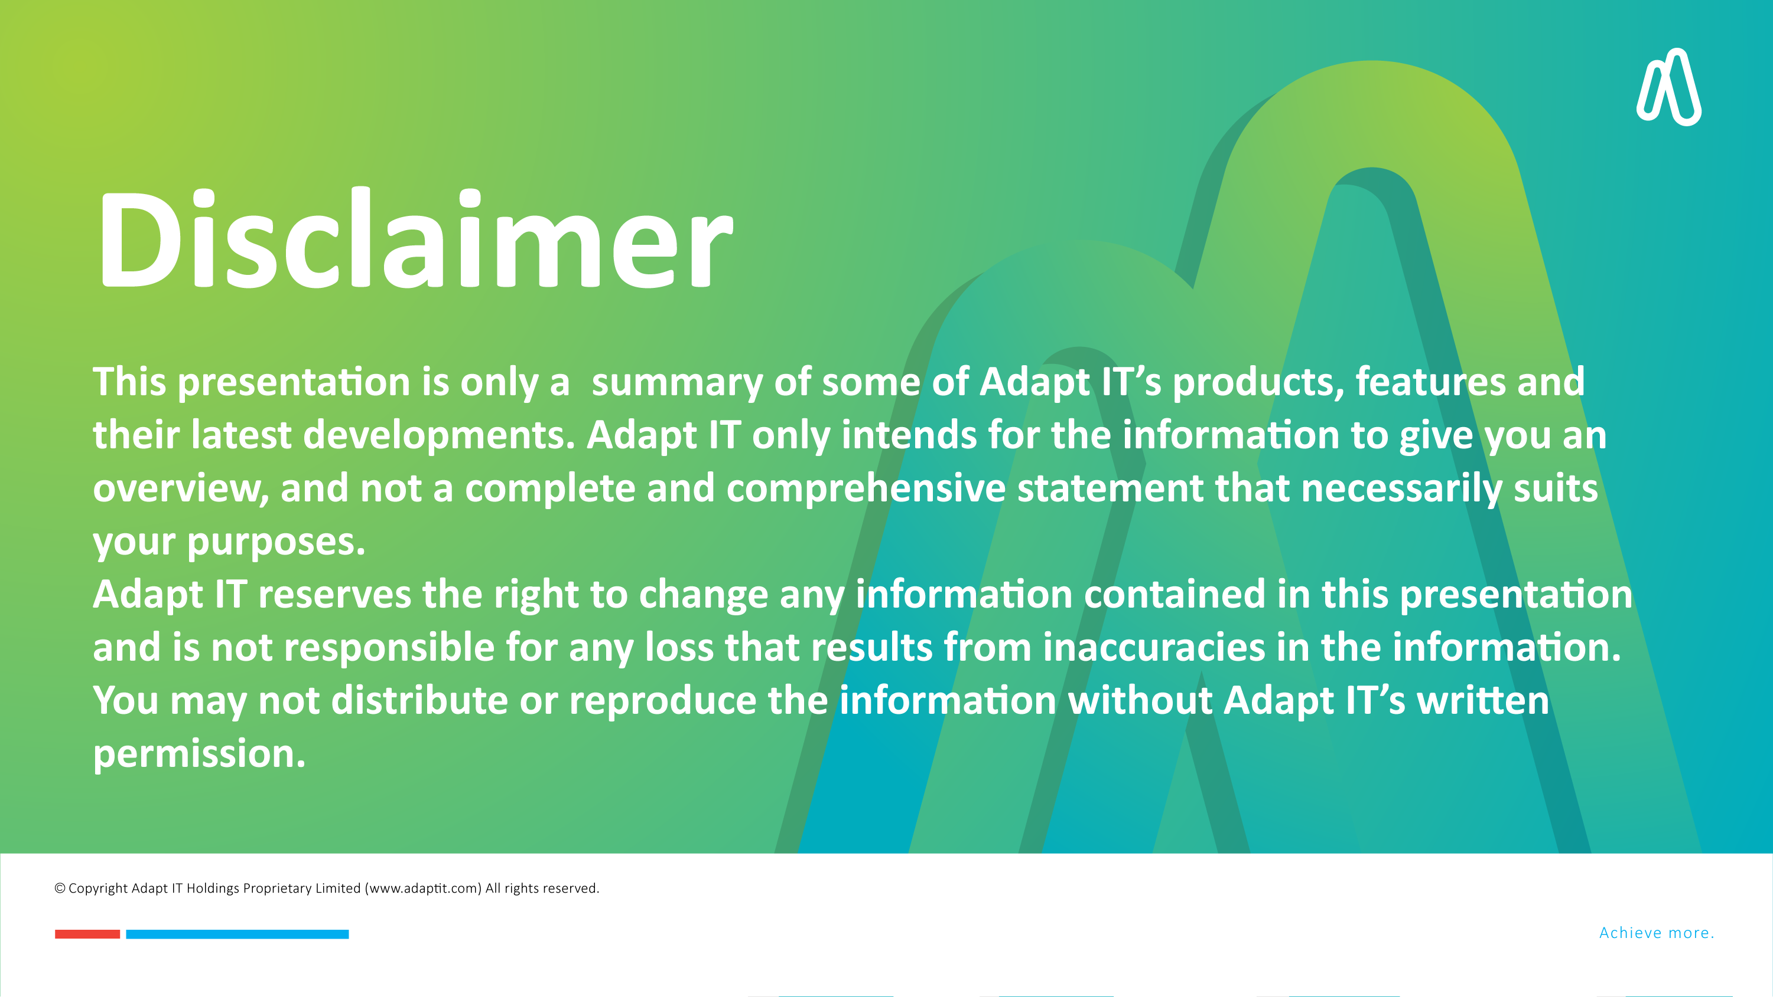

DISCLAIMER
This presentation is only a summary of some of Adapt IT’s products, features and their latest developments. Adapt IT only intends for the information to give you an overview, and not a complete and comprehensive statement that necessarily suits your purposes.
Adapt IT reserves the right to change any information contained in this presentation and is not responsible for any loss that results from inaccuracies in the information. You may not distribute or reproduce the information without Adapt IT’s written permission.

Slide 3

Terminology
Applications, Selections and APS & Eligibility (Highlights)
Applications, Selections and APS & Eligibility (Future Dev)
Infinity SIS Roadmap
Registrations – Student App
Registrations – Insights
Registrations (Features)
Your Thoughts & Comments
Table of contents

Slide 4
Terminology

Slide 5
Terminology
EAP
MVP
MMP
EIP
Early Adopter Program
  1st iteration of MVP
  Shared risk
  Access to development team
Minimum Viable Product
  Includes only the minimum capabilities required to be a viable customer solution
Minimum Marketable Product
  Standard product
  Can be rolled out to majority of our client base
Enhanced International Product
  Standard product with geographic enhancements

Slide 6
Applications, Selections and APS & Eligibility (Highlights)

Slide 7
Applications, Selections and APS & Eligibility (Highlights)
Applications
Selections
APS & Eligibility
  Undergrad & Postgrad
  New & Returning
  Local & International
  Inline APS
  Mobile
  Bulk update of Status
  Ranking
  Recalculation of APS & Eligibility
  Top-down setup
  Non-final results
  Eligibility block
  Complex rules

Slide 8
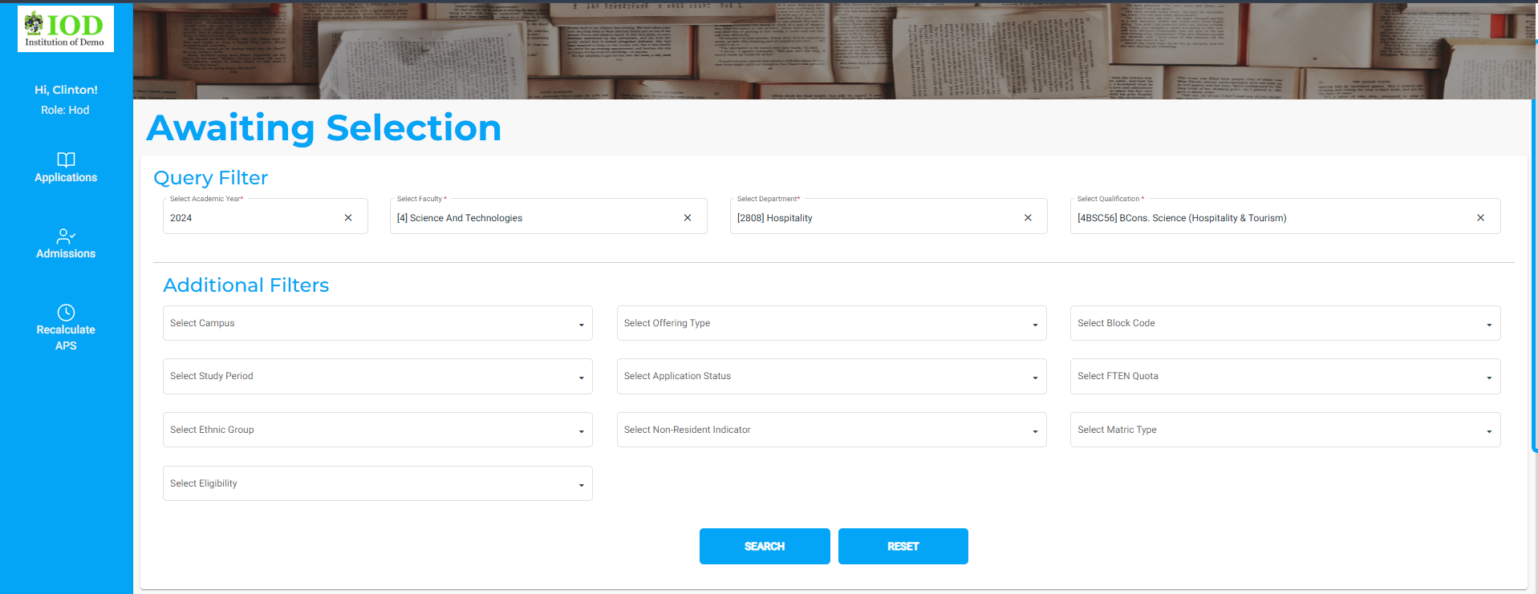
Applications, Selections and APS & Eligibility (Highlights)

Slide 9
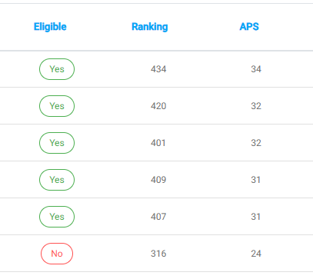
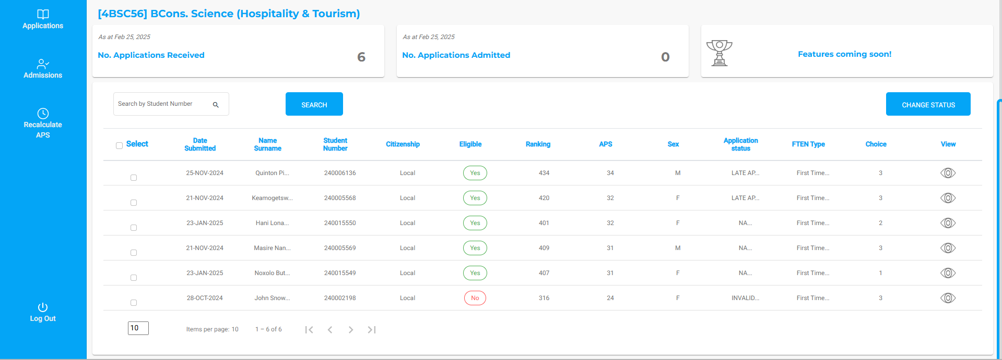
Applications, Selections and APS & Eligibility (Highlights)
1st
3rd
2nd

Slide 10
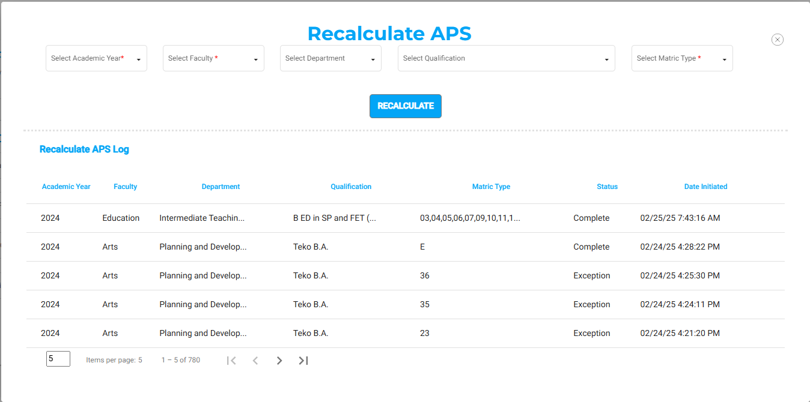
Applications, Selections and APS & Eligibility (Highlights)

Slide 11
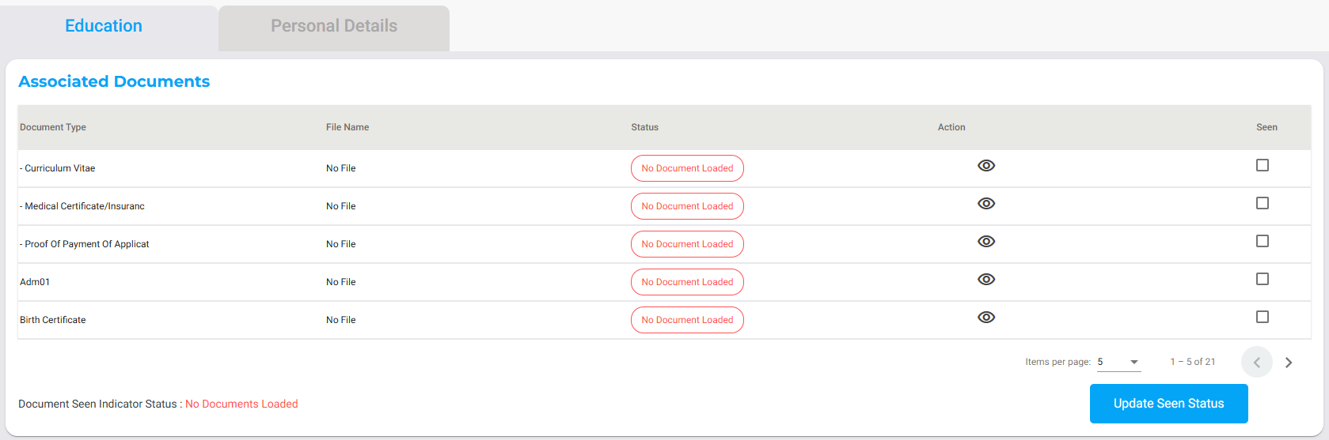
Applications, Selections and APS & Eligibility (Highlights)

Slide 12
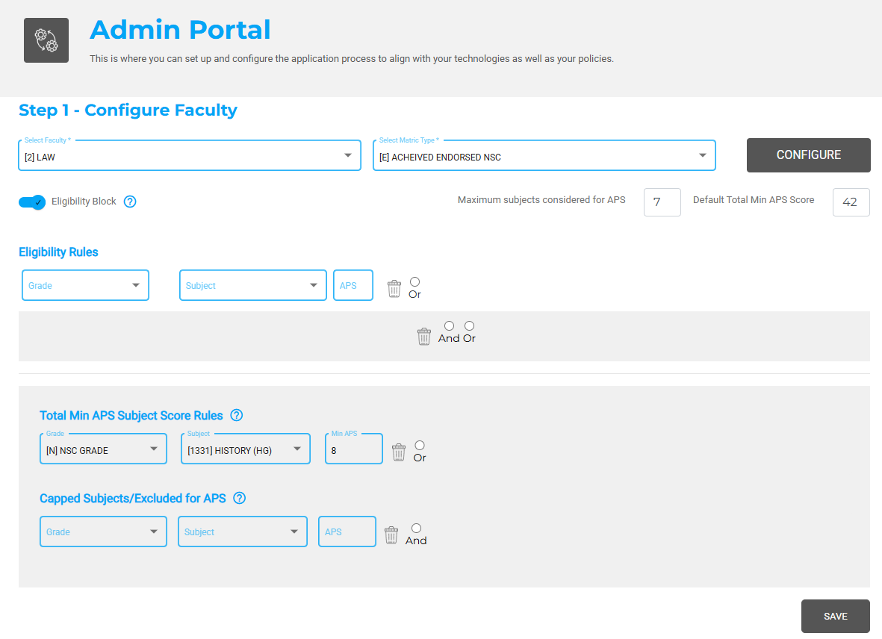
Applications, Selections and APS & Eligibility (Highlights)

Slide 13
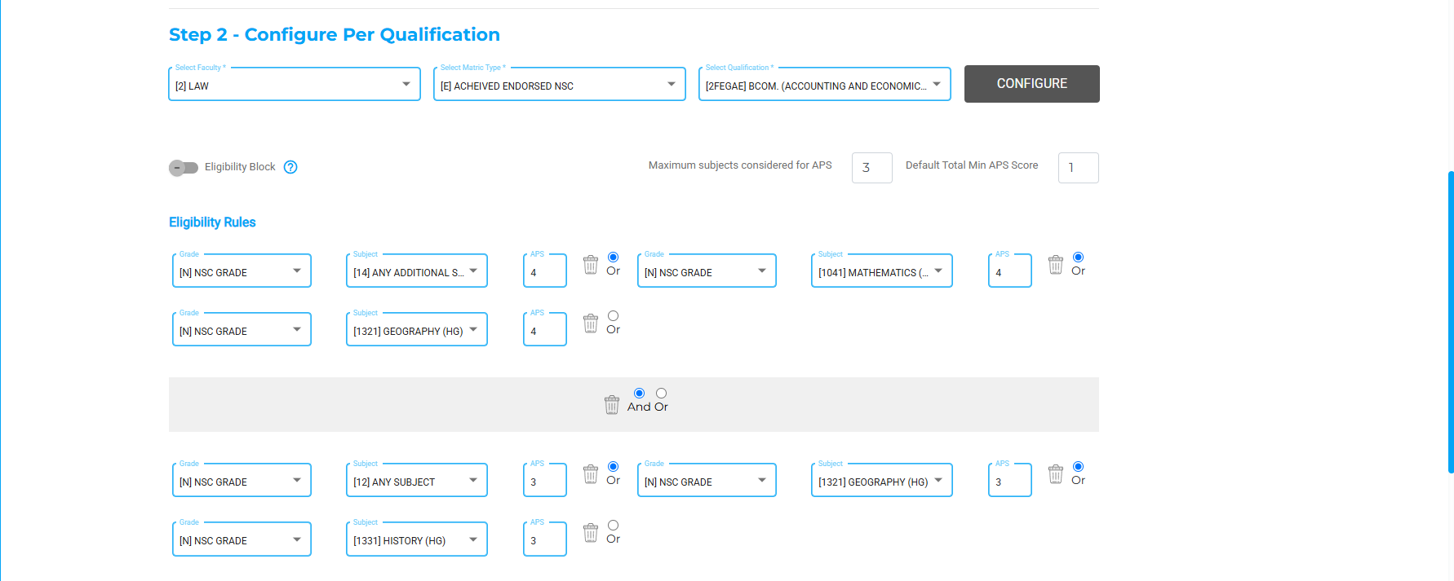
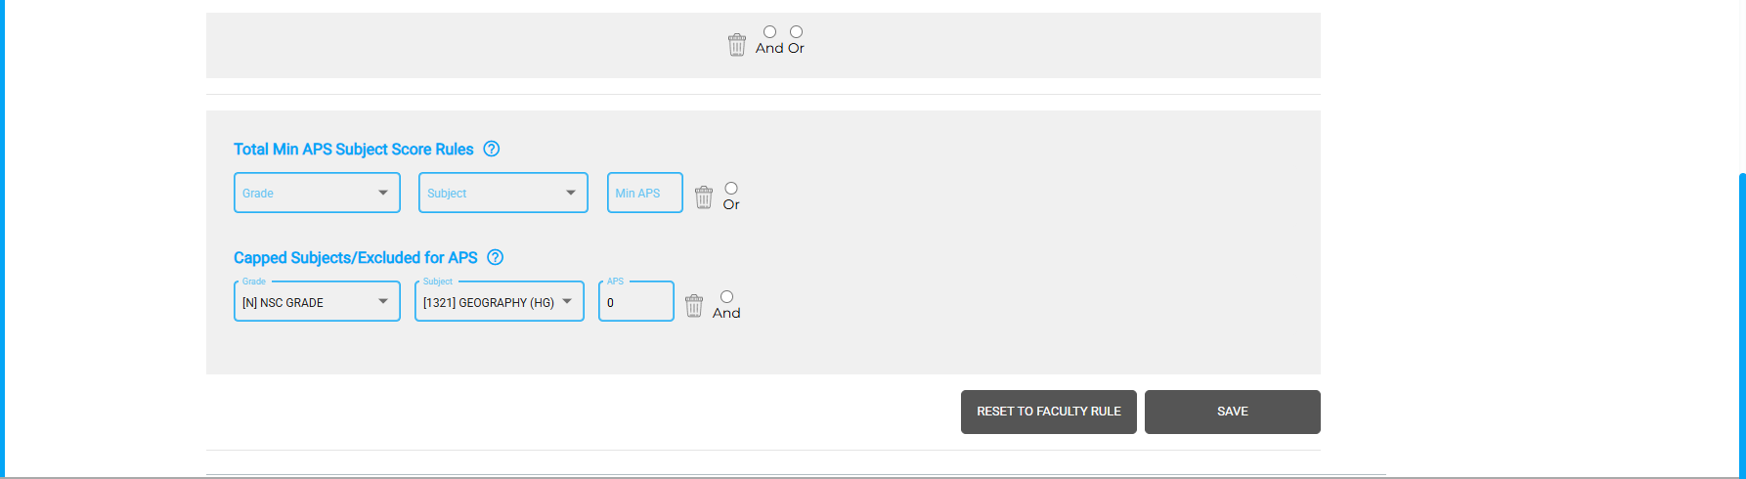
Applications, Selections and APS & Eligibility (Highlights)

Slide 14
Applications, Selections and APS & Eligibility (Future Dev)

Slide 15
Applications, Selections and APS & Eligibility (Future Dev)
Applications
Selections
  How would you like to study for this qual?
  Payments (PayGate)
  Short Courses / Skills
  Update status for all eligible students
  Insights (Headcount)

Slide 16
Infinity SIS Roadmap

Slide 17
Infinity SIS Roadmap
 | 2024 | 2025 | ???? | 2026 | 2026 | 2026 | 2027 |  | ????
Engagement Layer | Applications | Registrations | Residence |  | Student Self Service |  |  | Graduation | Alumni
Administrative /Data Management Layer | Application, Selections and APS & Eligibility Admin | Registrations Admin | Residence Admin | Course & Fees Admin | Student Finance Admin | Marks Admin | Progression Admin | Graduation Admin | Alumni Admin
Intelligence Layer | Applications & Selections Insights | Registrations Insights | Residence Insights | Course & Fees Insights | Student Insights | Marks Insights | Progression Insights | Graduation Insights | Alumni Insights
Core/System Layer
Data Layer
Document Storage
Communications - Email
API Orchestration
Infrastructure as code
Policies
Advanced Configs
Authentication
Scheduling
AWS Large File Sync
Branding Control
Defaults
Advanced Auditing
Security
Mobile/Web Capable
Dynamic Scaling
Users & Permissions
Workflows
3rd Party Integrations
Postgres
Oracle

Slide 18
Registrations – Student App

Slide 19
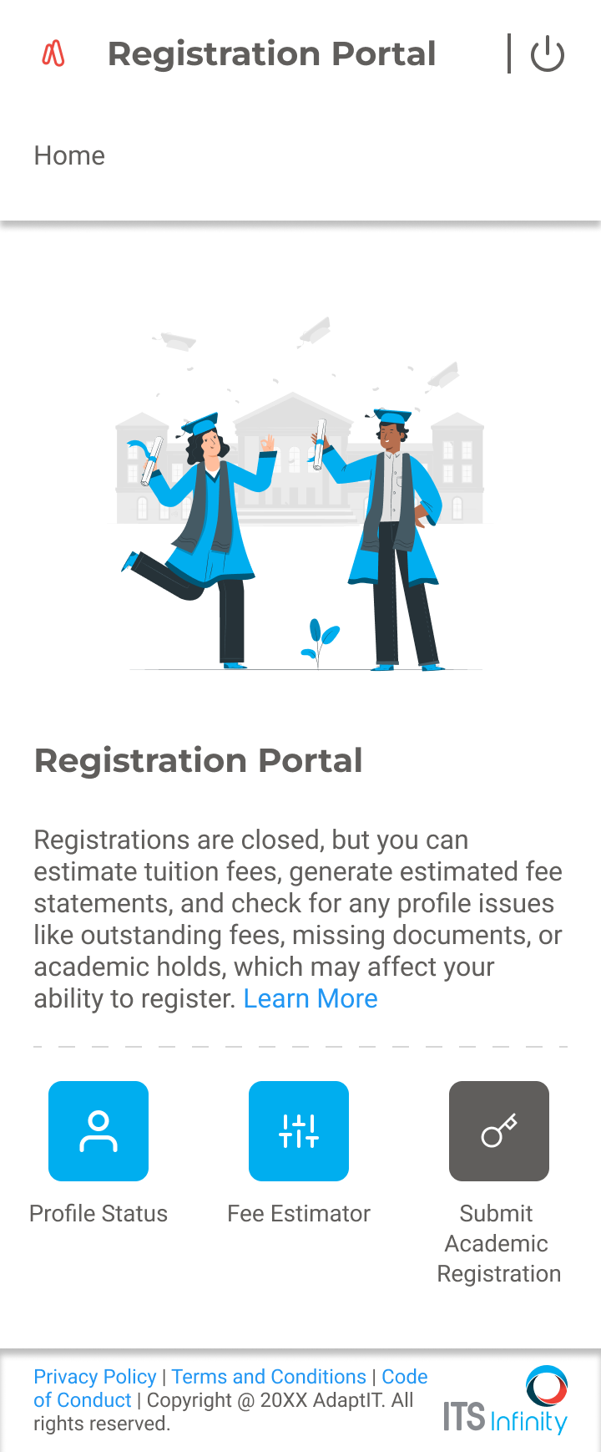

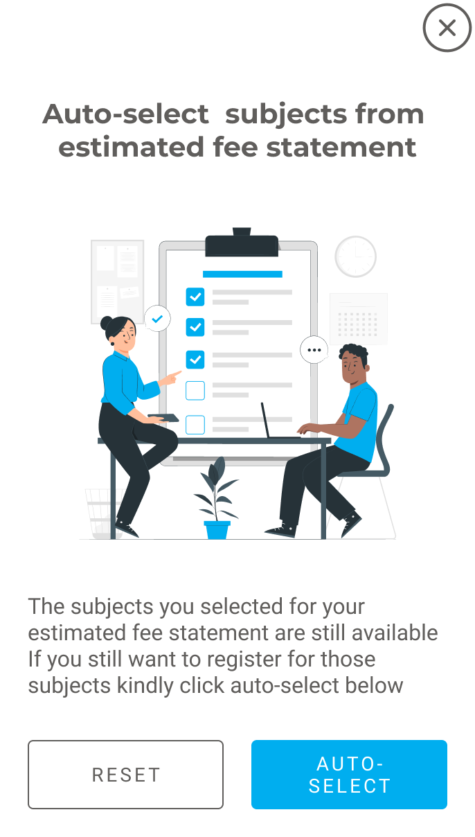

Registrations – Student App

Slide 20
Registrations – Insights

Slide 21
Registrations – Insights
https://www.figma.com/proto/pwTUI4GgZ0n3mevqRaG8Eu/Selections?node-id=300-20051&t=Nyk9yhNbaS8r0Q74-1&scaling=min-zoom&content-scaling=fixed&page-id=282%3A11135

Slide 22
Registrations (Features)

Slide 23
Registrations (Features)
Registrations
Fee estimator (Quote/Pro-Forma)
Payments (PayGate)
Quotas (Applications, Admissions, Registrations)
Prefill from Fee Estimator

Slide 24
Your Thoughts & Comments?

Slide 25



